Slide 1

Preparation for Lab 2
Week 4
Semester 1, 2025
Dr. Farshid Keivanian

Slide 2
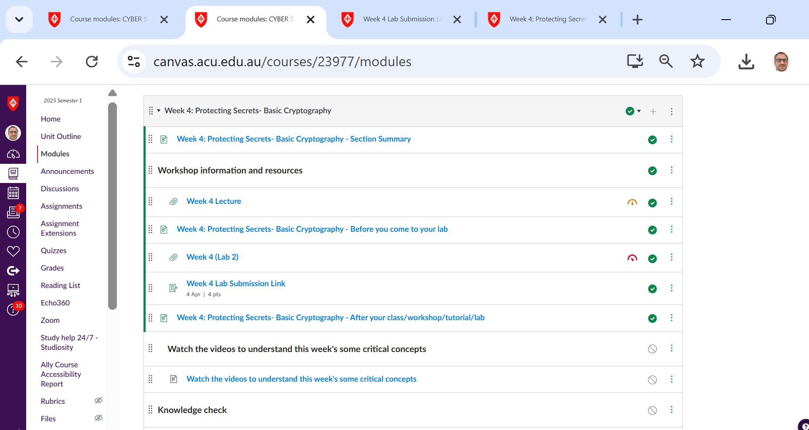
Preparation for Lab 2 (Week 4) – VirtualBox and Kali Linux
Navigate Canvas >> Week 4 >> Lab 2 (submit a word document with screenshot)

Slide 3
Preparation for Lab 2 (Week 4) – VirtualBox and Kali Linux
Introduction
Today, we will work with VirtualBox and Kali Linux to set up a virtual machine (VM) for penetration testing and security analysis. This lab will guide you step-by-step through installing VirtualBox and setting up Kali Linux.

Slide 4
Preparation for Lab 2 (Week 4) – VirtualBox and Kali Linux
What is VirtualBox?
VirtualBox is an open-source tool developed by Oracle that allows users to create and run multiple operating systems on a single computer. It supports Windows, macOS, and Linux machines.
Why Use VirtualBox?
Runs multiple OS environments on one device
Isolates software for testing and development
Useful for penetration testing and ethical hacking

Slide 5
Preparation for Lab 2 (Week 4) – VirtualBox and Kali Linux
What Are We Doing in This Lab?
This lab is about setting up a virtual environment where we can run Kali Linux inside Oracle VirtualBox on our Windows computer.
This means:
We don’t need to install Kali Linux directly on our main computer.
Instead, we create a virtual machine (VM) that runs Kali Linux inside Windows, like an app.
This allows us to experiment with cybersecurity tools in Kali Linux without affecting our main operating system.

Slide 6
Preparation for Lab 2 (Week 4) – VirtualBox and Kali Linux
What is Oracle VirtualBox Manager?
Oracle VirtualBox is a virtualization software.
It allows us to run multiple operating systems (like Kali Linux) inside our computer.
Think of it like a computer inside our computer.
Instead of buying a separate computer for Kali Linux, we use VirtualBox to create a virtual computer.

Slide 7
Preparation for Lab 2 (Week 4) – VirtualBox and Kali Linux
Main Purpose of VirtualBox in this Lab:
To install and run Kali Linux in a safe, isolated environment.

Slide 8
Preparation for Lab 2 (Week 4) – VirtualBox and Kali Linux
What is Kali Linux?
Kali Linux is a special operating system designed for penetration testing, cybersecurity, and ethical hacking.
It comes with many security tools used by cybersecurity professionals.
Kali Linux is based on Linux, meaning it looks and works differently from Windows.

Slide 9
Preparation for Lab 2 (Week 4) – VirtualBox and Kali Linux
Main Purpose of Kali Linux in this Lab:
To practice cybersecurity skills in a controlled environment.
To explore tools that help in ethical hacking, network security, and system security.

Slide 10
Preparation for Lab 2 (Week 4) – VirtualBox and Kali Linux
How Do VirtualBox and Kali Linux Work Together?
VirtualBox is the software that runs Kali Linux as a virtual machine. Here’s the relationship step-by-step:
We install VirtualBox on Windows.
This gives us the ability to create virtual computers.

Slide 11
Preparation for Lab 2 (Week 4) – VirtualBox and Kali Linux
We download and install Kali Linux inside VirtualBox.
Instead of installing it directly on our computer, we install it inside a virtual machine.
Now, we can use Kali Linux within VirtualBox.
We can open VirtualBox → Start Kali Linux → Use it without affecting our Windows system.

Slide 12
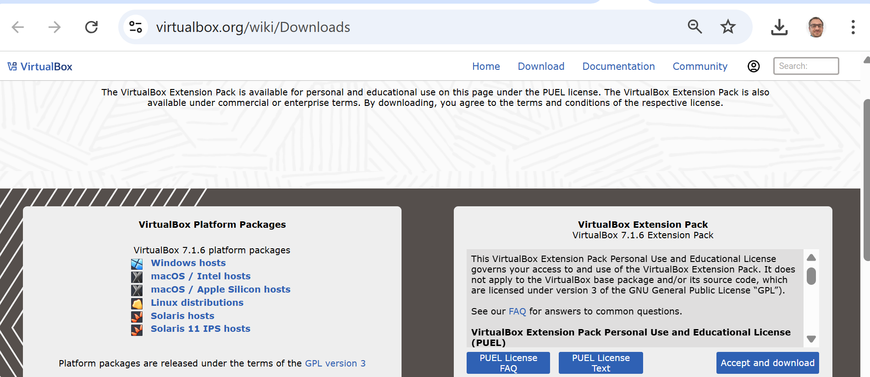
Preparation for Lab 2 (Week 4) – VirtualBox and Kali Linux
Installing VirtualBox
Follow these steps to install VirtualBox:
Download VirtualBox from the official website: https://www.virtualbox.org/wiki/Downloads
We should choose the "Windows hosts" option if we are installing VirtualBox on a Windows machine. If we are using macOS, we choose either "macOS / Intel hosts" or "macOS / Apple Silicon hosts", depending on our system.
For Linux users, we select "Linux distributions".

Slide 13
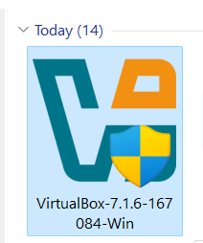
Preparation for Lab 2 (Week 4) – VirtualBox and Kali Linux
2. Once downloaded, locate the installation file on your computer and double-click to start the installation (Run as Administrator)

Slide 14
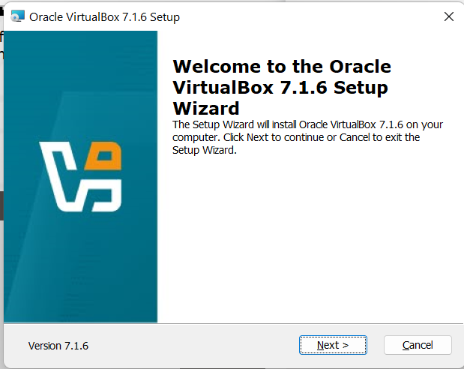
Preparation for Lab 2 (Week 4) – VirtualBox and Kali Linux
3. Click on Next

Slide 15
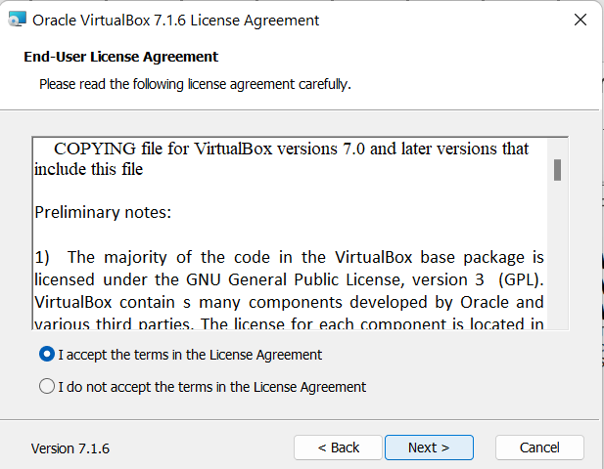
Preparation for Lab 2 (Week 4) – VirtualBox and Kali Linux
4. Accept & Click on Next

Slide 16
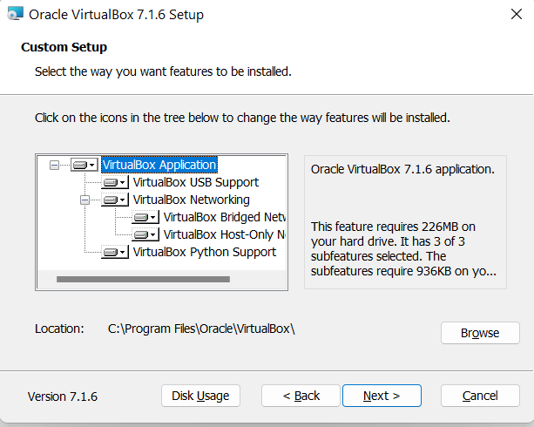
Preparation for Lab 2 (Week 4) – VirtualBox and Kali Linux
VirtualBox Application (Mandatory for installation)
VirtualBox USB Support (Recommended for USB device compatibility)
VirtualBox Networking (Includes Bridged Networking, Host-Only Networking, and other network features—recommended to keep)

Slide 17
Preparation for Lab 2 (Week 4) – VirtualBox and Kali Linux
VirtualBox Python Support (Optional, but useful if you plan to run automation scripts)
5. Keep the default options selected & proceed with the installation

Slide 18
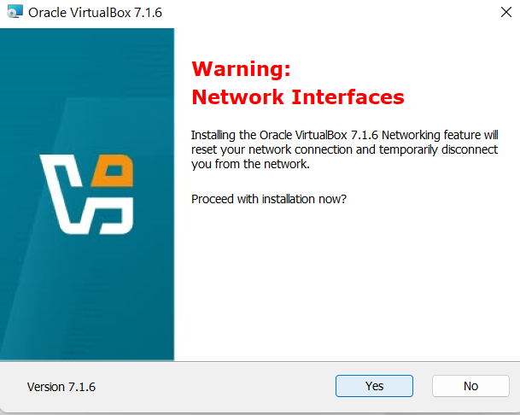
Preparation for Lab 2 (Week 4) – VirtualBox and Kali Linux
Click on Next & Yes

Slide 19
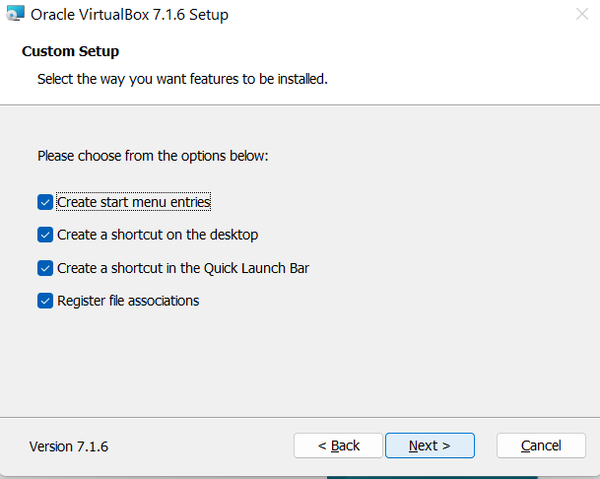
Preparation for Lab 2 (Week 4) – VirtualBox and Kali Linux
Next

Slide 20
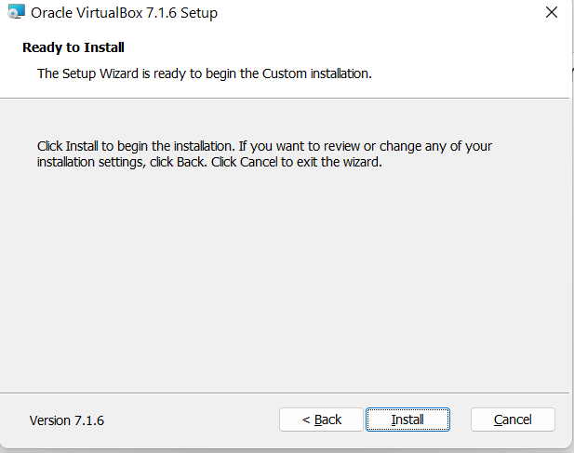
Preparation for Lab 2 (Week 4) – VirtualBox and Kali Linux
Install

Slide 21
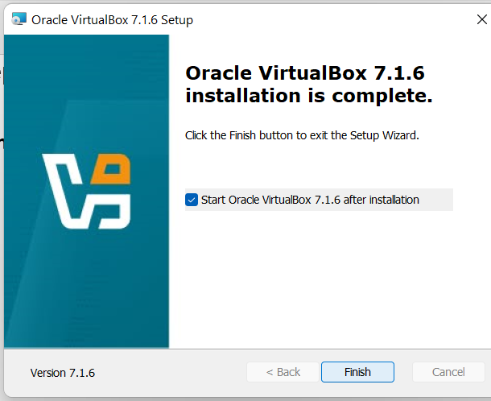
Preparation for Lab 2 (Week 4) – VirtualBox and Kali Linux
Click Finish to exit the setup wizard

Slide 22
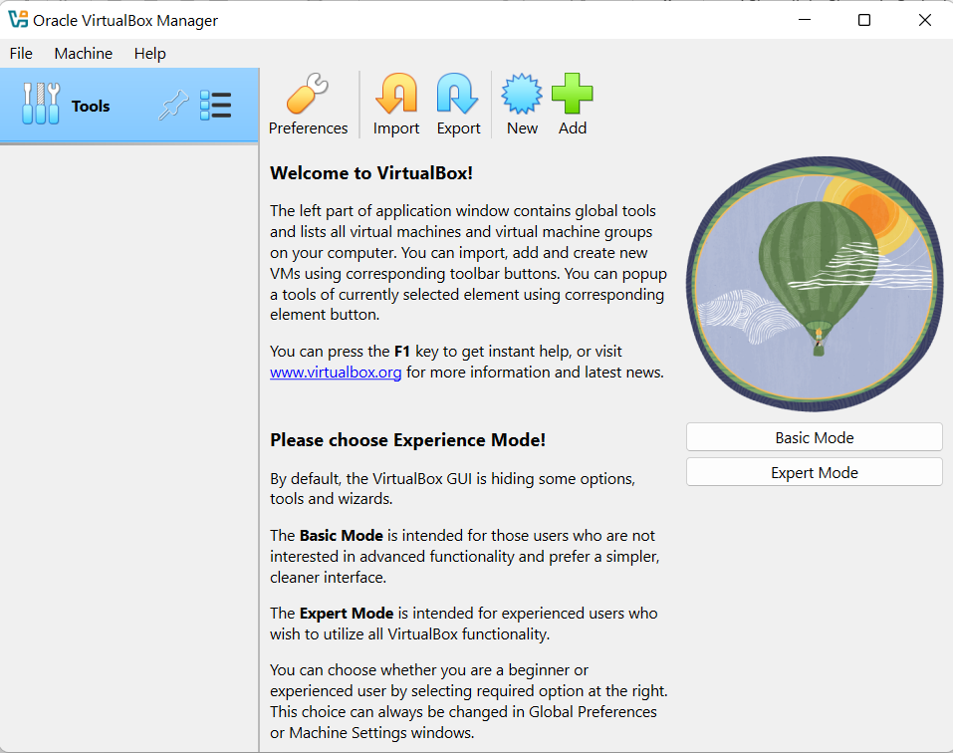
Preparation for Lab 2 (Week 4) – VirtualBox and Kali Linux
Now Virtual Box is ready to use
If you are a beginner, select "Basic Mode" (Recommended).
It provides a simpler interface with essential options for creating and managing virtual machines.

Slide 23
Preparation for Lab 2 (Week 4) – VirtualBox and Kali Linux
If you are comfortable with advanced settings, select "Expert Mode".
This mode gives you more flexibility when setting up virtual machines, such as manually configuring storage, memory, and network settings.

Slide 24
Preparation for Lab 2 (Week 4) – VirtualBox and Kali Linux
Currently, we select Basic Mode. We can always switch to Expert Mode later from the preferences if needed.

Slide 25
Preparation for Lab 2 (Week 4) – VirtualBox and Kali Linux
What is Kali Linux?
Kali Linux is a Linux distribution designed for penetration testing, security auditing, and ethical hacking. It comes pre-installed with a wide range of cybersecurity tools.

Slide 26
Preparation for Lab 2 (Week 4) – VirtualBox and Kali Linux
Why Use Kali Linux?
Includes essential security and penetration testing tools
Helps in cybersecurity training and research
Open-source and regularly updated

Slide 27
Preparation for Lab 2 (Week 4) – VirtualBox and Kali Linux
Installing Kali Linux on VirtualBox
Follow these steps to install Kali Linux on your VirtualBox:
Download Kali Linux from the official website: https://www.kali.org/downloads/

Slide 28
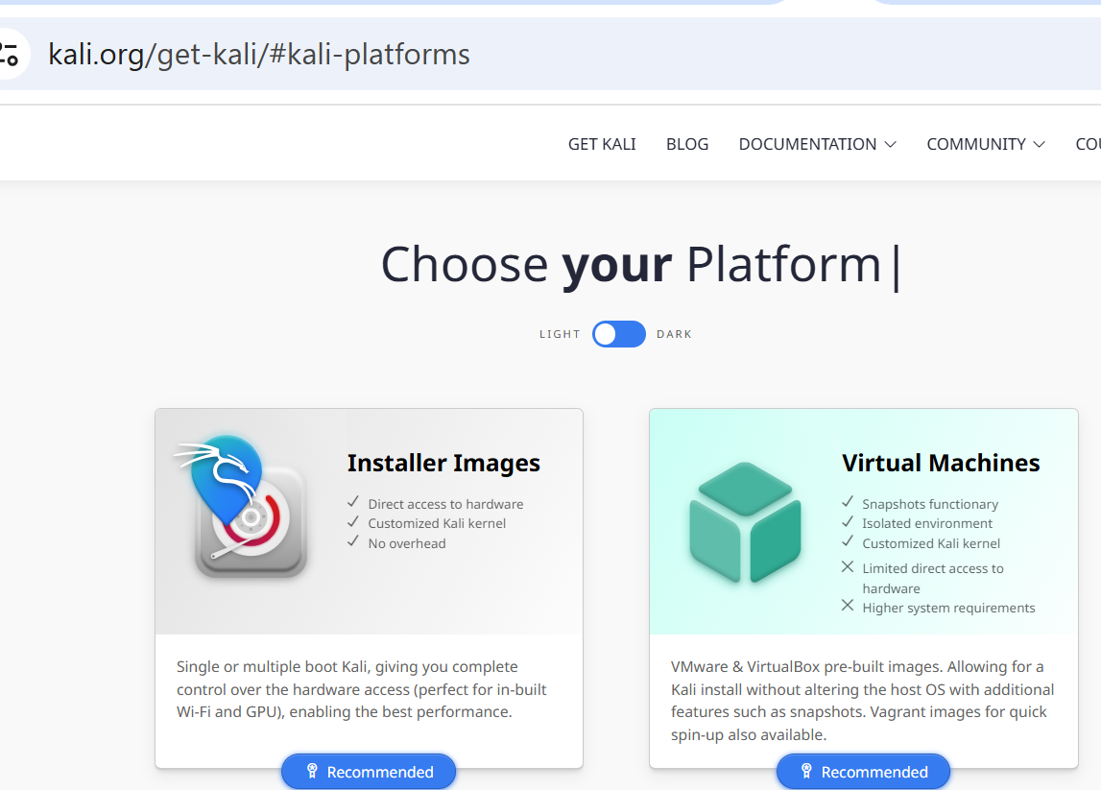
Preparation for Lab 2 (Week 4) – VirtualBox and Kali Linux
We are installing Kali Linux as a virtual machine (VM) inside VirtualBox.

Slide 29
Preparation for Lab 2 (Week 4) – VirtualBox and Kali Linux
"Virtual Machines" (the right option).
This option provides a pre-built Kali Linux image specifically for VirtualBox, making the installation process much easier and faster compared to using an ISO file.
After selecting Virtual Machines, proceed to download the VirtualBox version of Kali Linux.

Slide 30
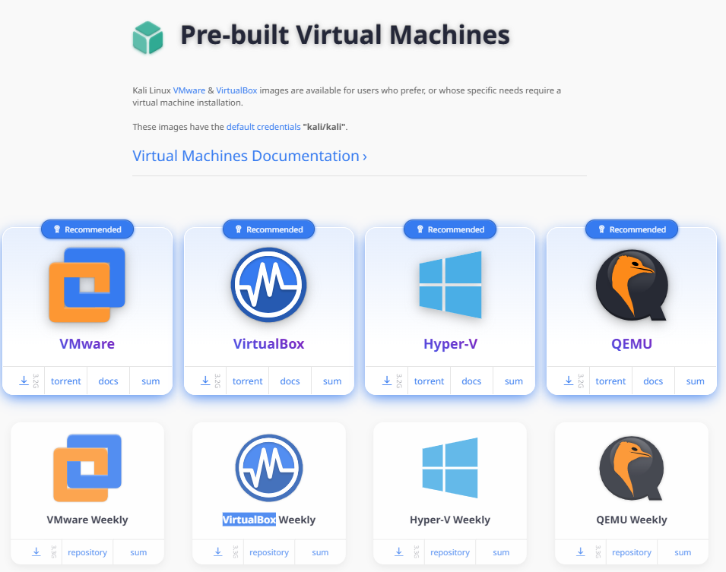
Preparation for Lab 2 (Week 4) – VirtualBox and Kali Linux
"VirtualBox" (the second option).
This will download a pre-built Virtual Machine (VM) image for Kali Linux that is already configured for VirtualBox. It will save you time compared to manually installing from an ISO file.
X Do not select VMware, Hyper-V, or QEMU, as they are for different virtualization platforms.
Once downloaded, import the VM into VirtualBox and proceed with the lab tasks.

Slide 31
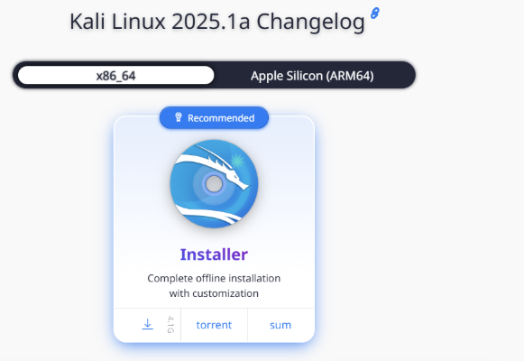
Preparation for Lab 2 (Week 4) – VirtualBox and Kali Linux
Since we are using Oracle VirtualBox, DO NOT choose the "Installer" option in the website.
Instead, we should: Go back and select "Virtual Machines“ (first page).
Then, choose "VirtualBox" to download the pre-built VM for VirtualBox.

Slide 32
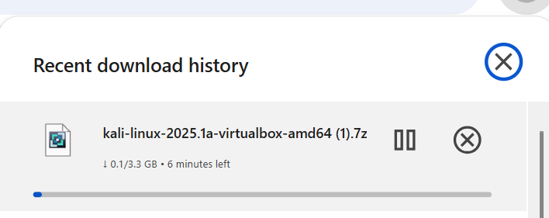
Preparation for Lab 2 (Week 4) – VirtualBox and Kali Linux
Wait 5-6 minutes until the file is completed

Slide 33
Preparation for Lab 2 (Week 4) – VirtualBox and Kali Linux
The .7z file needs to be extracted using 7-Zip before you can import it.
Extract it and look for a .ova file inside.
Download and install 7-Zip from https://www.7-zip.org/.
Right-click on your .7z file.
Select 7-Zip → Extract Here (or choose another location).
After extraction, look for the .ova file.
Online Extraction (If You Don't Want to Install Software)
Extract.me
ezyZip

Slide 34
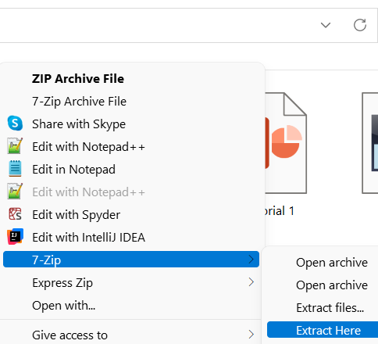
Preparation for Lab 2 (Week 4) – VirtualBox and Kali Linux
Right Click >> 7-Zip >> Extract Here

Slide 35
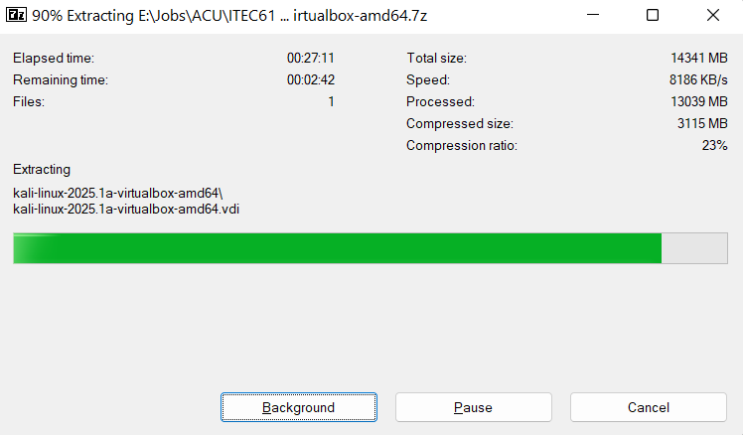
Preparation for Lab 2 (Week 4) – VirtualBox and Kali Linux
It may take more than 25 min

Slide 36
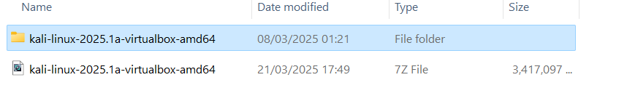
Preparation for Lab 2 (Week 4) – VirtualBox and Kali Linux
Extract completed

Slide 37
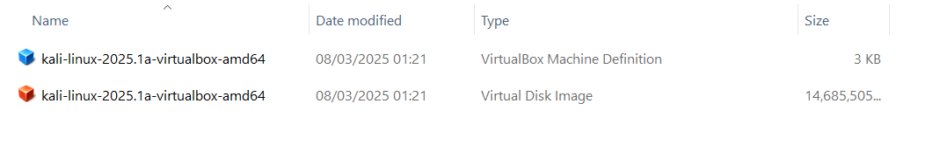
Preparation for Lab 2 (Week 4) – VirtualBox and Kali Linux
While VirtualBox is running, double click on file with lower size to import it into VirtualBox (or Click on Import Applicant if .ova file exists)

Slide 38
Preparation for Lab 2 (Week 4) – VirtualBox and Kali Linux
X Do NOT select:
Installer Images (.iso) → Used for full installations on a real machine.
Weekly, NetInstaller, Everything → These are advanced and require manual setup.
Live Boot, WSL, ARM, Cloud, Containers → Not meant for VirtualBox

Slide 39
Preparation for Lab 2 (Week 4) – VirtualBox and Kali Linux
Once imported, start the Kali Linux VM and log in with:
Username: kali
Password: kali
VirtualBox >> Click New
Set the name as Kali Linux
Select Type: Linux and Version: Debian (64-bit)
Allocate at least 2GB RAM (recommended: 4GB or more)
Create a virtual hard disk (20GB minimum)

Slide 40
Preparation for Lab 2 (Week 4) – VirtualBox and Kali Linux
Login Credentials for Kali Linux:
Kali Linux 2019:
Username: root
Password: toor
Kali Linux 2020 and later:
Username: kali
Password: kali
Now, Kali Linux is installed and ready to use!

Slide 41
Preparation for Lab 2 (Week 4) – VirtualBox and Kali Linux
Complete Lab Tasks
Take a screenshot of your Kali Linux desktop after a successful installation.
List all problems you encountered during this lab and provide recommendations to fix them.

Slide 42
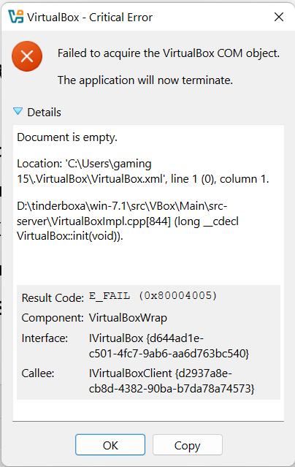
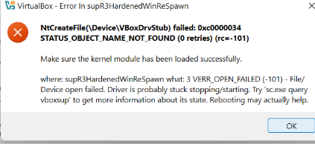
Preparation for Lab 2 (Week 4) – VirtualBox and Kali Linux
In case, if you saw an error like these:
Solution 1: Restart Your Computer
First, restart your computer and try starting Kali Linux again.
If the issue continues, move to Solution 2.

Slide 43
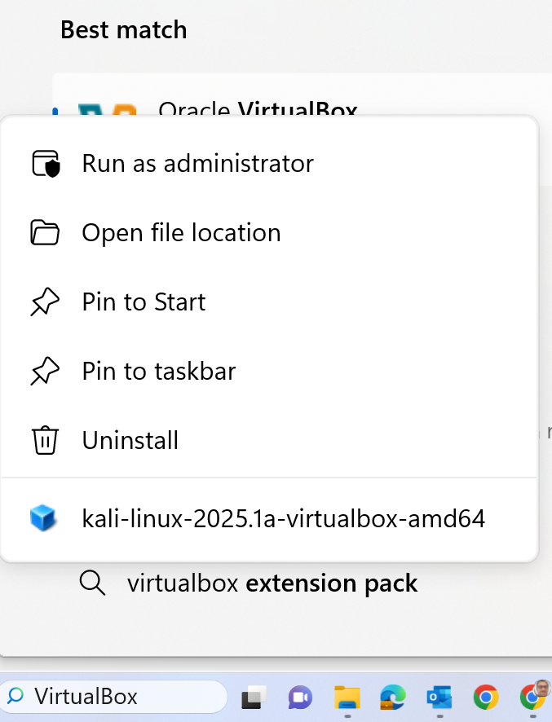
Preparation for Lab 2 (Week 4) – VirtualBox and Kali Linux
Solution 2: Run VirtualBox as Administrator
Close VirtualBox completely.
Right-click on the VirtualBox icon and select "Run as administrator".
Try starting Kali Linux again.

Slide 44
Preparation for Lab 2 (Week 4) – VirtualBox and Kali Linux
Solution 3: Reinstall VritualBox Drivers and VirtualBox Program

Slide 45
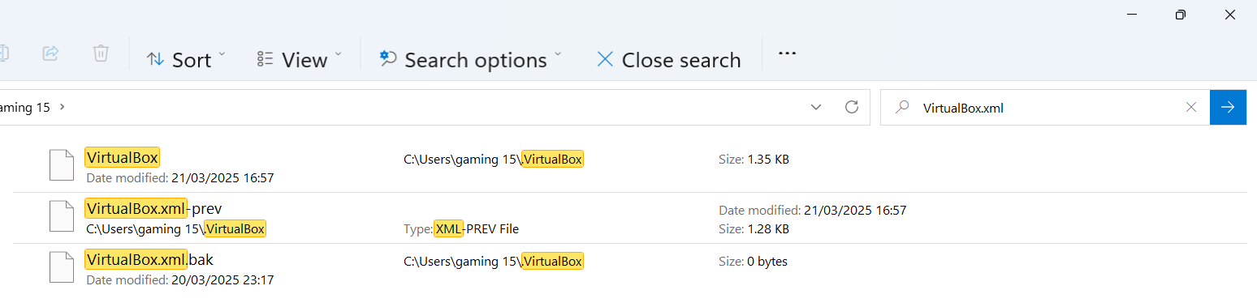
Preparation for Lab 2 (Week 4) – VirtualBox and Kali Linux
Solution 4:
Find the VirtualBox.xml file in your File Explorer: C:\Users\...
If the file is empty or corrupt, rename it to VirtualBox.xml.bak.
Restart VirtualBox to let it generate a new configuration file.

Slide 46
Preparation for Lab 2 (Week 4) – VirtualBox and Kali Linux
Things to Remember:
Follow the steps carefully.
If you face errors, double-check your settings and ensure you downloaded the correct files.
Take notes on issues and how you fixed them – this will help in troubleshooting future problems.
Final Tip: Always back up important data before making significant changes to your system!

Slide 47
Summary of Lab 2 (Week 4)
Preparation for Lab 2 (Week 4) – VirtualBox and Kali Linux
Step 1: Install VirtualBox
Download Oracle VirtualBox.
Install it on your Windows computer.
Step 2: Download Kali Linux
We need the right version for VirtualBox.
There are two ways to do this:
Easier Method (Recommended): Download the Kali Linux VirtualBox Image (.ova file).
Harder Method: Download the Kali Linux ISO file and install it manually.

Slide 48
Summary of Lab 2 (Week 4)
Preparation for Lab 2 (Week 4) – VirtualBox and Kali Linux
Step 3: Import Kali Linux into VirtualBox
If you downloaded the .ova file, just import it into VirtualBox.
If you downloaded the .iso file, you will install Kali Linux manually in VirtualBox.
Step 4: Start and Use Kali Linux
Once installed, start Kali Linux inside VirtualBox.
Use Kali Linux to complete the lab tasks.

Slide 49
Summary of Lab 2 (Week 4)
Preparation for Lab 2 (Week 4) – VirtualBox and Kali Linux
Step 5: Complete Lab Questions
Take a screenshot of Kali Linux running inside VirtualBox.
List any problems you faced and how you solved them.

Slide 50
Summary of Lab 2 (Week 4)
Preparation for Lab 2 (Week 4) – VirtualBox and Kali Linux
This lab helps us:
Understand virtualization and how to run different operating systems.
Learn how to install and configure VirtualBox and Kali Linux.
Prepare for cybersecurity tasks in a safe virtual environment.
Use Kali Linux tools without affecting our main Windows system.

Slide 51
Summary of Lab 2 (Week 4)
Preparation for Lab 2 (Week 4) – VirtualBox and Kali Linux
Final Thought
Think of Oracle VirtualBox as a TV and Kali Linux as a video game console.
VirtualBox (TV) is the platform that runs different operating systems.
Kali Linux (Game Console) is the system we use inside VirtualBox to practice cybersecurity

Slide 52
Submission of Labs & Assessments
These guidelines are designed to support your learning and help you apply necessary techniques effectively. For lab or assessment submissions, please follow instructions and complete tasks based on Canvas. If you have any questions, feel free to ask—I’m happy to help!

Slide 53
Thank You
Have a Great Learning Day!
Feel free to reach out with any questions!
Dr. Farshid Keivanian

